Slide 1
Artist Recommender System using Spark and Python
Presented By:
Akilesh A

Slide 2
Problem Statement and Objectives
Problem Statement:
With increasing access to 4G services in India, people have started to hear a lot of songs from music streaming apps like Spotify.
A person logging in to the app can play any song from the huge collection and in doing so, he expresses his current state of mind and his/her liking towards an artist.
After this, there is a need for a recommendation system to suggest similar artists which the user may like to suit the person’s interest, especially in case of a diverse audience.
Objectives:
To create a recommender system that recommends artists that a user may like based on their listening history.
To learn about Collaborative Filtering and how Apache Spark helps to implement the same.

Slide 3
Dataset and BDA Tool Selection
Dataset:
"Music Listening Dataset“ by Audioscrobbler (Now part of Last.fm).
The Audioscrobbler data set contains profiles for around 150,000 people.
The Dataset has 3 files namely:
user_artist_data.txt: This file contains data for each user_id and corresponding artist_id that they like and data here refers to the number of plays.
artist_data.txt: This file contains a map between artist ids and artist names.
artist_alias.txt: This file contains artist_ids that resolves to the same artist. (Ex. Spelling mistakes, nick names, etc.)
BDA Tools used:
Apache Spark
Google Colab
Language: Python 3.9

Slide 4
Implementation: Algorithm
Collaborative Filtering:
Why?: The selected dataset records only the interaction between the user and the song and no other information is collected other than the artist’s names.
Analogy : “ People also like…”
Limitation: Cold-start problem: If there is a new song, no-one else would’ve yet liked or listened to it, so the algorithm never recommends it, even if the song is probably good.
Alternating Least Squares Method:
Alternating least squares is the default implementation of collaborative filtering in Spark under pyspark.mllib library.
It is a matrix factorization algorithm and can be used even in very large datasets as it makes use of many cores present in the system.

Slide 5
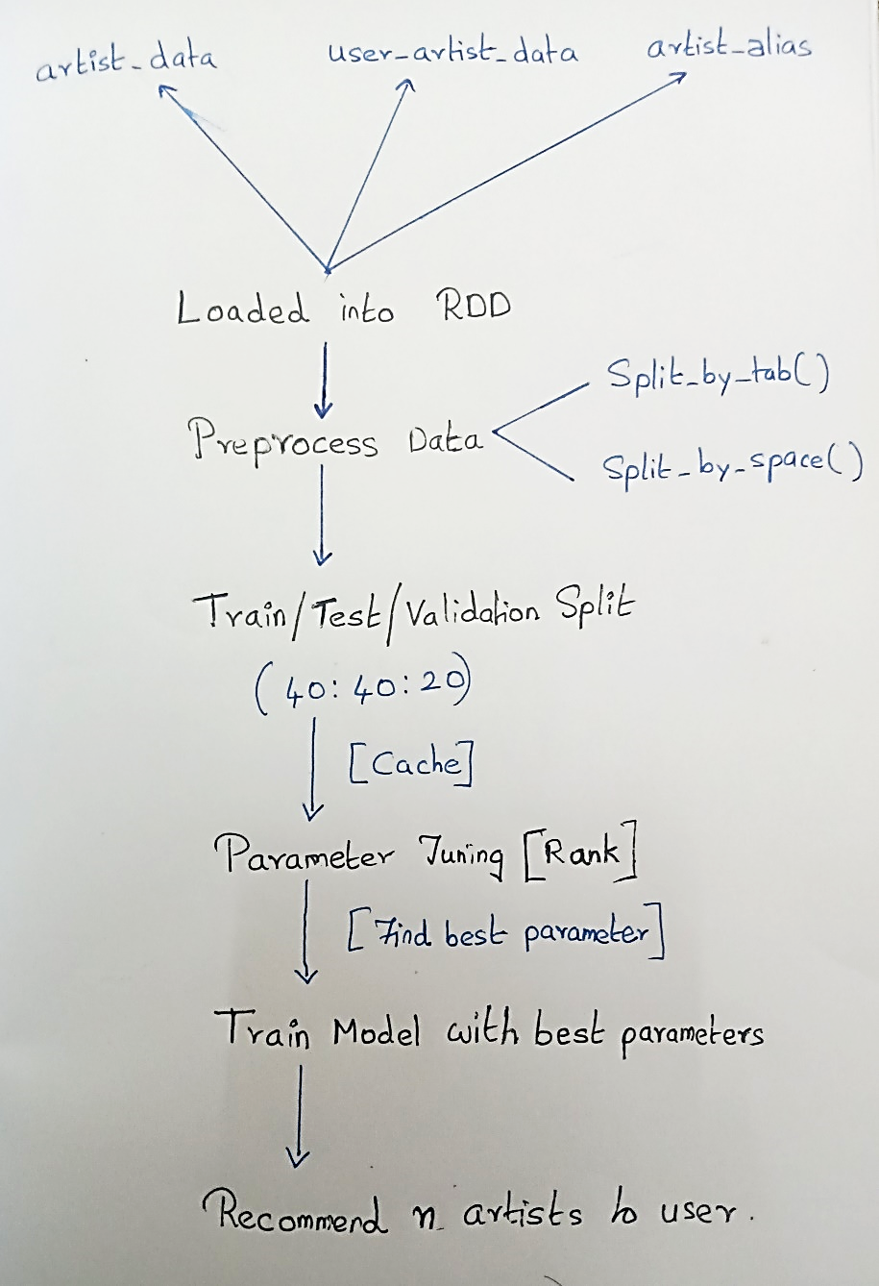
Implementation: Method
Flow Diagram:

Slide 6
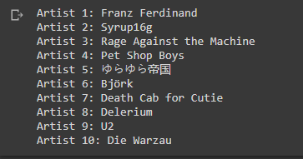
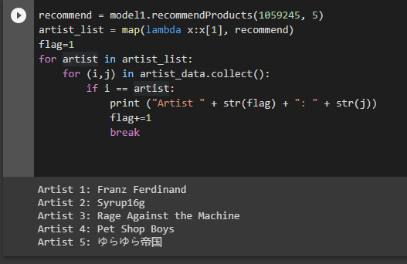
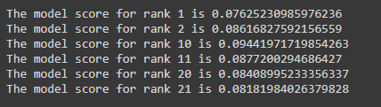
Experimental Results/Snapshots
Please refer code.

Slide 7
Results and Discussion
Conclusion:
Thus, a recommender system is created using Alternating Least Squares method based on Collaborative Filtering technique.
Learnt how collaborative filtering works and implement the same in Python using Apache Spark.
Business Use of the Project:
Any streaming platform that respects privacy by not collecting user data (age, gender, etc) can use this method as an alternative to Content based recommendation.
Future Scope of the Project:
Compare other algorithms/ implementations of collaborative filtering technique with ALS and check how it performs with this dataset
Implementing the same on Databricks platform.

